Slide 1
Technology and Development: Associated Risk in Adoption of Technology

Slide 2
Technology and human identity
Technology has been at the heart of human progress since earliest times. Our pre-human ancestors fashioned sticks to reach for food, used leaves to sop up water and hurled stones in anger, just as chimpanzees do today.
The first human species is named Homo habilis—the “handy man”. Its fossils from some 2.5 million years ago lie with chipped pebbles, the first unequivocal stone tools. Early Homo may have used the perishable technologies of gourds to drink water and leather slings to carry infants. About half a million years ago, Homo erectus fashioned elegant leaf shaped hand axes throughout Africa, Asia and Europe and was apparently using fire.
Our own species, Homo sapiens—the “wise man” from some 40,000 years ago in Europe, the Middle East and Australia— made tools of stone, bone and antler as well as necklaces for adornment, and drew symbolic art on rock walls—technology in the service of ideas and communication (Jolly, 2000).

Slide 3
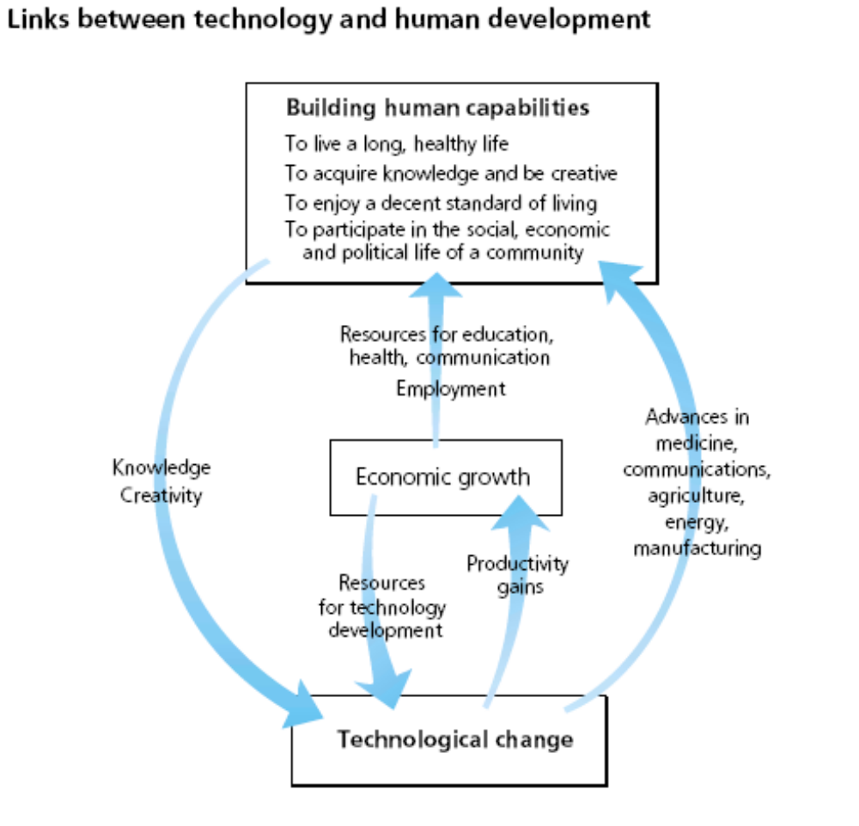

Slide 4
Technology and Human Development
Twenty first Century may be termed as a period of rapid technological developments and information revolution.
Infuse tremendous challenges and opportunities in social, economic, political, technical and cultural processes affecting nearly all economies.
The use of computers and networks in information dissemination has greatly enhanced human development in our society.

Slide 5
The basic purpose of development is to enlarge people's choices. These choices can be infinite and can change over time.
People often value achievements that do not show up at all, or not immediately, in income or growth figures: greater access to knowledge, better nutrition and health services, more secure livelihoods, security against crime and physical violence, satisfying leisure hours, political and cultural freedoms and sense of participation in community activities.
The objective of development is to create an enabling environment for people to enjoy long, healthy and creative lives. (Mahbub ul Haq)

Slide 6
Personal development
Reaching more of personal potential
Being more satisfied and fulfilled in life
People understanding their own personal values
People knowing themselves more
Knowing own skills, talents, qualities
Knowing what they like, what is really satisfying
Knowing about strengths and weaknesses, and how to complement them by working together with others in teams
Role of I T
I&T in education.
I&T in professional development
Personal development planning
E-portfolios.

Slide 7
It is believe that people gain access to technological once they have more income.
Economic growth creates opportunities for useful innovations to be created and diffused.
However, the process can also be reversed: investments in technology, like investments in education, can equip people with better tools and make them more productive and prosperous.
Technology is a tool, not just a reward, for growth and development.

Slide 8
The revolution of IT sector is a blessing for Human Development.
The Internet, the wireless telephone and other information and communications technology enable people to communicate and obtain information in ways never before possible, dramatically opening up possibilities to participate in decisions that affect their lives.
Information and communications technology can provide rapid, low-cost access to information about almost all areas of human activity.
From distance learning in Turkey to long-distance medical diagnosis in the Gambia, to information on market prices of grain in India, the Internet is breaking barriers of geography, making markets more efficient, creating opportunities for income generation and enabling increased local participation.

Slide 9
In 1989 biotechnological research into hepatitis B resulted in a breakthrough vaccine.
Much more can be done to develop vaccines and treatments for HIV/AIDS and other diseases endemic in some developing countries.
Transgenic offers the hope of crops with higher yields, pest- and drought-resistant properties and superior nutritional characteristics—especially for farmers in ecological zones left behind by the green revolution.
In China genetically modified rice offers 15% higher yields without the need for increases in other farm inputs, and modified cotton (Bt cotton) allows pesticide spraying to be reduced from 30 to 3 times.

Slide 10
Technology is created in response to market pressures—not the needs of poor people.
Research and development, personnel and finance are concentrated in rich countries, led by global corporations and following the global market demand dominated by high-income consumers.
Developing countries may gain especially high rewards from new technologies, but they also face especially severe challenges in managing the risks.
All countries, even the poorest, need to implement policies that encourage innovation, access and the development of advanced skills.
New international initiatives and the fair use of global rules are needed to channel new technologies towards the most urgent needs of the world’s poor people.

Slide 11
Risk of Technological Change
Technological advance brings potential benefits and risks, some of which are not easy to predict.
Societies respond to these uncertainties by seeking to maximize the benefits and minimize the risks of technological change.
Though the agricultural technology of the green revolution more than doubled cereal production in Asia between 1970 and 1995, the impacts on farm workers’ income and on the environment are still hotly debated.

Slide 12
Why adopt new technologies?
Potential benefits: the possibilities for promoting development through today’s technological transformations are tremendous in developing countries.
Costs of inertia versus costs of change: New technologies often improve on the ones they replace: the modern jet, for example, is safer and faster than the propeller aero-plane.
Means of managing risks: Many potential harms can be managed and their likelihood reduced through systematic scientific research, regulation and institutional capacity. When these capacities are strong, countries are far more able to ensure that technological change becomes a positive force for development.

Slide 13
Most developing countries are at a disadvantage in the face of technological change because they lack the regulatory institutions needed to manage the risks well.
But there can be advantages to being technological followers. Unlike front-runners, followers do not incur the first-mover risks of using new technologies: they can instead observe how those risks play out in other countries.
They can also learn from others in designing their regulations and institutions. Moreover, for some technologies they may be able to establish low-cost regulatory systems that build on, or even rely on, the regulatory standards of early adopters.

Slide 14
ASSESSING POTENTIAL COSTS AND BENEFITS
Some risks of technological change are rooted in human behavior and social organization.
Biotechnological research can be turned into weapons if governments or terrorists choose that path.
Could the genes flowing from genetically modified organisms into non-target organisms endanger non-target populations?
Could using mobile telephones cause brain or eye cancer?

Slide 15
Two potential harms may be:
Possible harms to human health: Technologies have long posed threats to human health. Some pollute air and water: power plants using fossil fuels produce sulphur dioxide, which in high concentrations can irritate the upper respiratory tract. Others can introduce harmful substances to the body through medicines, such as thalidomide, or through the food chain.
With genetically modified foods, the two main concerns are that the introduction of novel genes could make a food toxic and that they could introduce new allergens into foods, causing reactions in some people.

Slide 16
Possible harms to the environment: Some claim that genetically modified organisms could destabilize ecosystems and reduce biodiversity in three ways.
First, transformed organisms could displace existing species and change the ecosystem.
History shows the danger: six European rabbits introduced in Australia in the 1850s soon multiplied into 100 million, destroying habitats and native flora and fauna. Today the rabbits cost Australian agricultural industries $370 million a year.

Slide 17
Second, gene flow among plants could transfer the novel genes into related species, leading, for example, to super weeds.
Third, the novel genes could have unintended harmful effects on non-target species. Laboratory studies have shown that the pollen of Bt corn, designed for pest control against stem borers, can also kill monarch butterflies if enough is consumed.
Some of these risks are the same in every country: potential harms to health from mobile phones or to unborn children from thalidomide are no different for people in Malaysia than in Morocco—though the ability to monitor and handle them may vary considerably.

Slide 18
But other risks vary significantly: gene flow from genetically modified corn would be more likely to happen in an environment with many corn-related wild species than in one without.
For this reason, the environmental risks of biotechnology are often specific to individual ecosystems and need to be assessed case by case. Risks to human health are more common across continents.

Slide 19
A full risk assessment needs to weigh the expected harms of a new technology against its expected benefits—and compare these to:
The expected value of harms and benefits of existing technologies that would be replaced.
The expected value of harms and benefits of alternative technologies that might be preferable to new or existing technologies.

Slide 20
TAKING PRECAUTIONS
Precautionary principle often interpreted as the rule that a country can or should reject the products of new technologies when full scientific certainty that such products will not cause harm is lacking.
Use the precautionary principle
A variety of precautionary principles are in use, ranging from soft to strong formulations.
A relatively soft formulation appears in the 1992 Rio Declaration on Environment and Development, where it says that “to protect the environment, the precautionary approach shall be widely applied by states according to their capability. Where there are threats of serious or irreversible damage, lack of full scientific certainty shall not be used as a reason for postponing cost-effective measures to prevent environmental degradation.”

Slide 21
That is, regulators can take cost-effective steps to prevent serious or irreversible harm even when there is no certainty that such harm will occur.
A strong formulation is set out in the 1990 Third Ministerial Declaration on the North Sea, which requires governments to “apply the precautionary principle, that is to take action to avoid potentially damaging impacts of [toxic] substances . . . even where there is no scientific evidence to prove a causal link between emissions and effects.”
This formulation requires governments to take action without considering offsetting factors and without scientific evidence of harm.

Slide 22
Six elements might differ between soft and strong formulations:
Consideration of benefits and risks in current technology: Soft formulations guide regulatory action by considering not only the harmful risks of technological change but also the potential benefits, as well as the risks of technology that would be removed. Strong formulations, in contrast, often examine only the direct risks of the new technology.
Cost-effectiveness of prevention: Soft formulations emphasize the need to balance the costs of preventing potential environmental harms associated with a new technology against the costs of those harms. Strong formulations often do not weigh the costs of prevention.

Slide 23
Certainty of harm or certainty of safety: Unlike in Soft formulations, Strong formulations often require certainty of safety to avoid regulatory action (which in complex and dynamic systems is often impossible to achieve).
Burden of proof: Soft formulations place the burden of proof on those who claim that harm will occur if a new technology is introduced. Strong formulations may shift the burden of proof to the producers and importers of a technology, requiring that they demonstrate its safety.

Slide 24
Optional or obligatory action: Soft formulations permit regulators to take action, while strong formulations often require action.
Locus of decision-making: Soft formulations place authority in regulators, while strong formulations may vest power in political leaders.

Slide 25
BUILDING THE CAPACITY TO MANAGE RISK
USING SCIENTIFIC INFORMATION: TURNING UNCERTAINTY INTO RISK
In the absence of information, there is uncertainty. Scientific research generates information about the likely impacts of a new technology, turning that uncertainty into risk—the estimated probability that a certain harmful impact will occur. With more and better information, risk can be more accurately predicted and better managed.

Slide 26
ENSURING PUBLIC PARTICIPATION THROUGH RISK COMMUNICATION
Recent debates on the commercialization of agricultural biotechnology have underscored the importance of public participation and education on its risks—because the public ultimately produces and consumes the products of new technology.
A recent survey in Australia highlights the need for better education: 49% of respondents feel that the risks of agricultural biotechnology outweigh its benefits, but 59% could not name a specific risk.

Slide 27
CREATING FLEXIBLE INSTITUTIONS AND DIVERSE TECHNOLOGIES
If societies are to manage technology safely, they need not only flexible and responsive institutions but also a range of technology options for creating alternative solutions—hence the need to invest in building institutional and research capacity.

Slide 28
CHALLENGES FACING DEVELOPING COUNTRIES
Shortage of skilled personnel.
Inadequate resources: The cost of establishing and maintaining a regulatory framework can be a severe financial demand on poor countries.
Weak communications strategies: The extent of public awareness about genetically modified organisms varies among developing countries, but in many there is no official communications strategy for informing the public about them and about how biosafety is being handled. The typical difficulties of mounting effective public information campaigns are compounded by high rates of illiteracy in some countries and the lack of a tradition of public empowerment and of consumer activists demanding information and asserting their right to know.

Slide 29
Inadequate feedback mechanisms: Technology is ultimately put to use not in laboratories but in homes and schools, on farms and in factories. A user’s ability to follow safety procedures determines whether the benefits of technology can be reaped or will be lost. But mechanisms for providing information to and gathering feedback from users may not be well developed. In developing countries such mechanisms for providing information and gathering feedback are typically weaker.

Slide 30
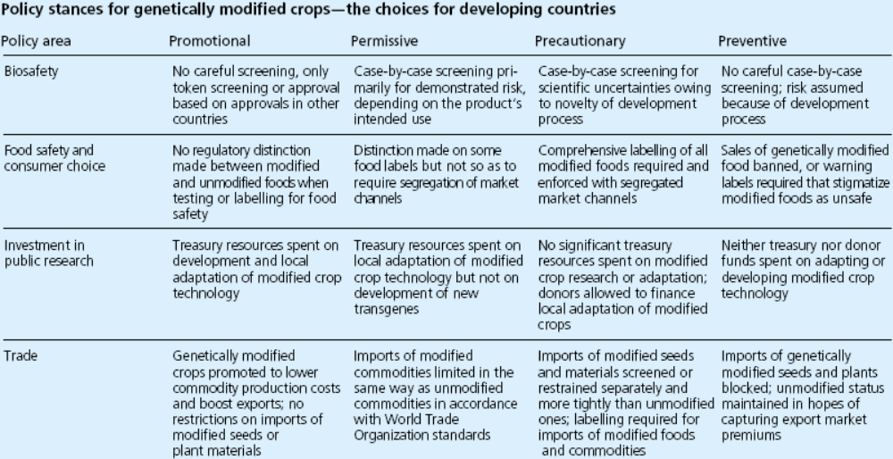
Source: Paarlberg 2000.

